Slide 1
Clash of Cos
Team Pitch
by Luke Bell, Sam Bagshaw, Sujai Bhuiyan, and Charlie Ashall

Slide 2
Team Introduction
Luke Bell on
Sam Bagshaw on Level Design
Sujai Bhuiyan on Research & asset acquisition
Charlie Ashall on Mechanic Creation
[I need to add images to slides]​
by Luke Bell, Sam Bagshaw, Sujai Bhuiyan, and Charlie Ashall

Slide 3
Research and Inspiration

Slide 4
Genre Inspiration Mash
Fast top-down action game – hotline miami (we wanted to combine the balls to wall action of Hotline with the wacky physics of games like gangbeasts)
Gang beasts (the most popular of physics fighters made it the easiest to draw inspiration from)
While hades & Isaac hang out in the backrooms of potential
Hades – inspired the inclusion of fake (trashy) "gods" into the narrative to appear as bosses, that due to the wacky tone of the game still give items (a combination with similarity to Isaac).

Slide 5
Environment Inspiration
hotline miami esc level design with realife environment inspiration:
Hotels
Restaurants
Spa
Raves
Storage/supply rooms
(+ Gang beast influence)

Slide 6
Summary for Clash of Cos
Top-Down Action game
Target Audience – 12+ gamers (silly, but skill level helps)
For PC
[I need to add images to slides]

Slide 7
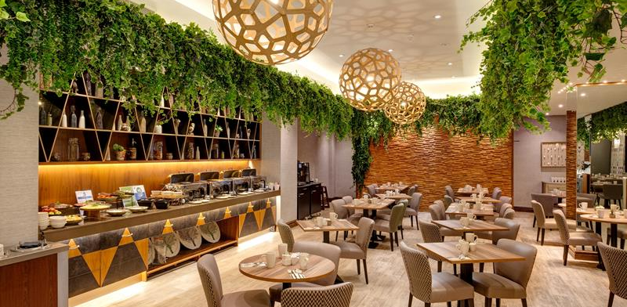
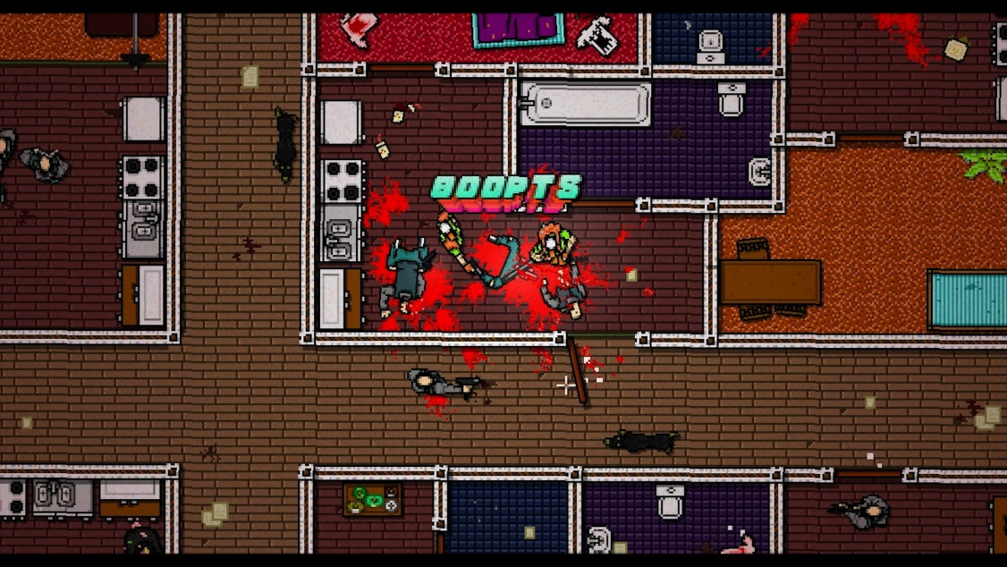
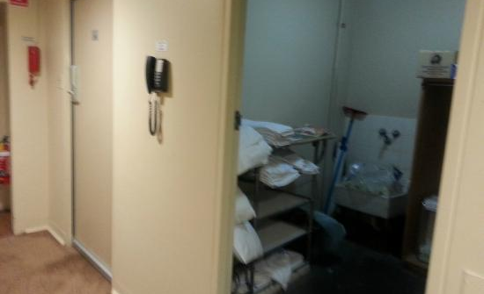
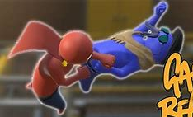
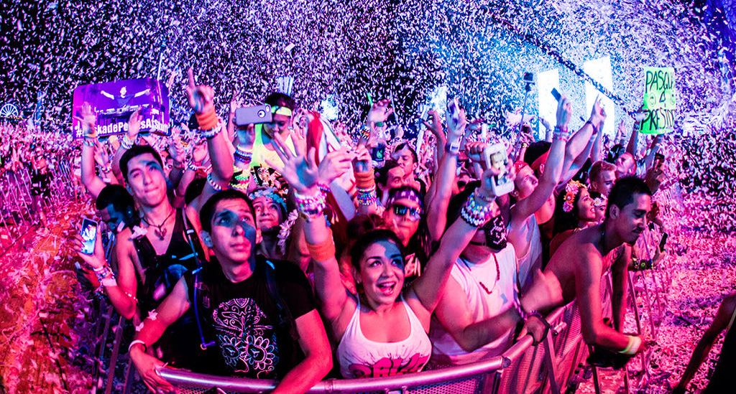
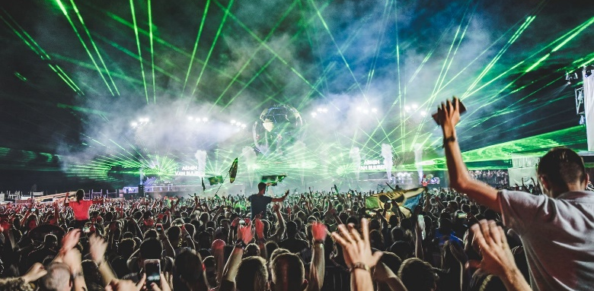
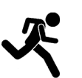

Overall Game Mood-board
Momentum – punch – knockback
Empty hotel turned (rave/show) fight club

Slide 8
Narrative Context
This is a show
Ran by enthusiasts with time to spare
they wear costumes in which they fight each other for entertainment
The most prolific of contestants got to claim a popular character and space for themselves

Slide 9
Mechanics and Gameplay

Slide 10
Gameplay Mood-board/Video/Example
Video Link/Video

Slide 11
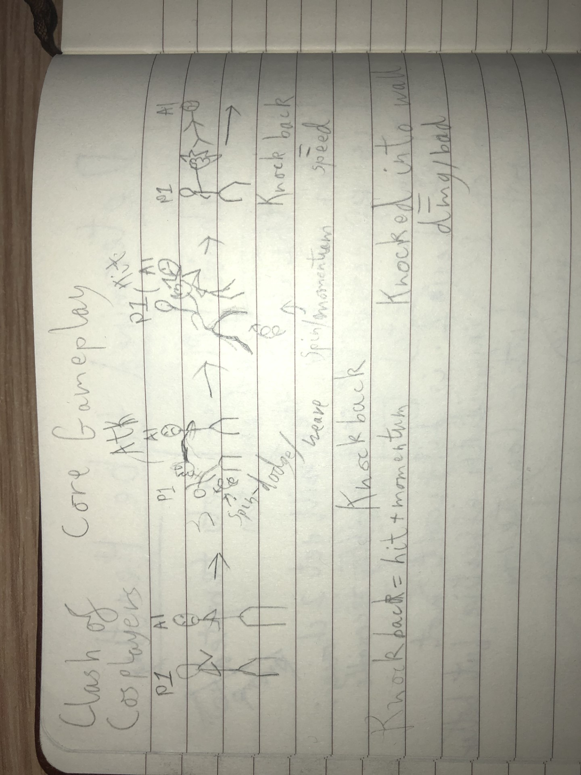
Core Gameplay
Weave/dodge swing/attack ragdoll/knockback/damage
This game hopes to combine that with high speeds and the corresponding dynamic decision-making. Hopefully resulting in wacky game with the most unexpectedly high technical skill ceiling

Slide 12
Core Gameplay Inspiration
We modelled our attacks and dodges on Gang beast
Physics can be surprisingly technical, dodging then using that momentum to attack. That is what we wanted for ourselves.
This game hopes to combine that with high speeds and the corresponding dynamic decision-making. Hopefully resulting in wacky game with the most unexpectedly high technical skill ceiling

Slide 13
Knock back

Slide 14
Improvements we would Implement

Slide 15
Area Claiming
Story wise the player is a new contestant fighting veteran contestants that were given their own areas, it stands to reason the player should get their own as well.
Two ways I see it working (maybe do both) allows players to either make a level for other players to challenge, or let each stage be used as communal areas after completion that the players can use as hubs to talk to NPC's with
Note – page too wordy, Summaries this page & add images

Slide 16
Costumes
The enemies are in costume, why not the player too (the only reason is lack of time and resources)
Could even unlock costume pieces from enemies the player defeats

Slide 17
Implementation that requires Polish
These are in game, but could use refining to meet our intention

Slide 18
Interaction
[Controls layout]

Slide 19
Equipment
We don’t need many buttons, so we could bind each equip key to corelating socket

Slide 20
Items

Slide 21
[Item-Category] Trolley

Slide 22
Threats

Slide 23
Basic Thug
We can add enemy variety with different weapons/equipment
Bosses could also add variety (if we perscribe sufficient time)
No weapons (so little damage)
Only option is to attack player with melee
{maybe we allow friendly fire – helps with the repetitive nature of melee enemies ganging up on the player, and also entertaining}
[each enemy weapon type we use will have it's own slide to allow for more detail]

Slide 24
Zeus – AI Boss Enemy
Takes more hits to beat
Can use lighting to damage and stun/ragdoll player
Defeat gives Taser

Slide 25
World Mechanics

Slide 26
Wall Bounce
Knock back into wall deals little extra damage [additional cool thing to make combat more varied]

Slide 27
Conveyer Belt
[Very gangbeasts – also additional]

Slide 28
Terrain that is item
Tables and furniture and stuff that player can use as a wall or cover, but also pick up for shenanigans (violence) [also additional]

Slide 29
Non-Player Characters

Slide 30
Announcer
Basicaly Narator
They explain things
Game is basicaly a game show that they announce [either text or voiced dialogue would work fine]
They are a hype man, they're dramatic, and snarky

Slide 31
"Zeus"
[explanation of double Zeus entry]While they are a threat, they're presence as an NPC would be separate from Zeus the threat if we did not make the connection clear (through label and narative context)
Will talk shit
Talk about the good fight (even if they lost – like they're trying to save face)
Will break character eventually
Egotist nerd

Slide 32
Game to Player Feedback
Ways the game will convey information to the player
Combat
Ragdolls need to be Obvious
Ideally sound effect indicate impact/damage
Progress indicators
An enemy count could work
Anoucer comments
Boss Talks

Slide 33
Level Designs

Slide 34
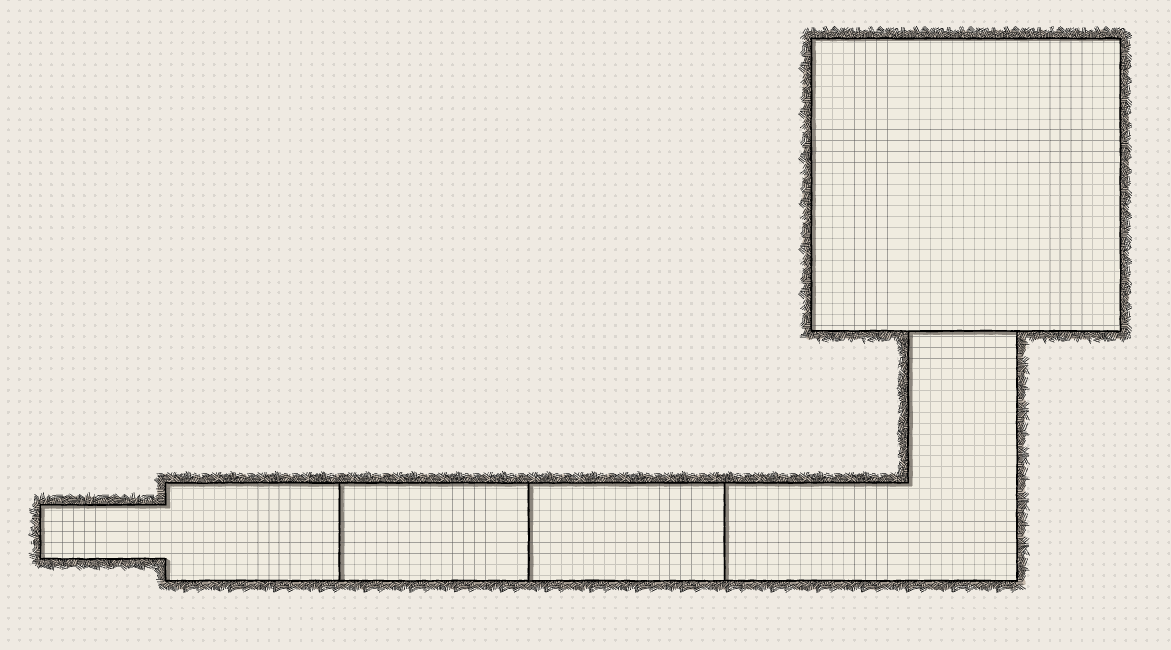
Tutorial Design Sketch

Slide 35
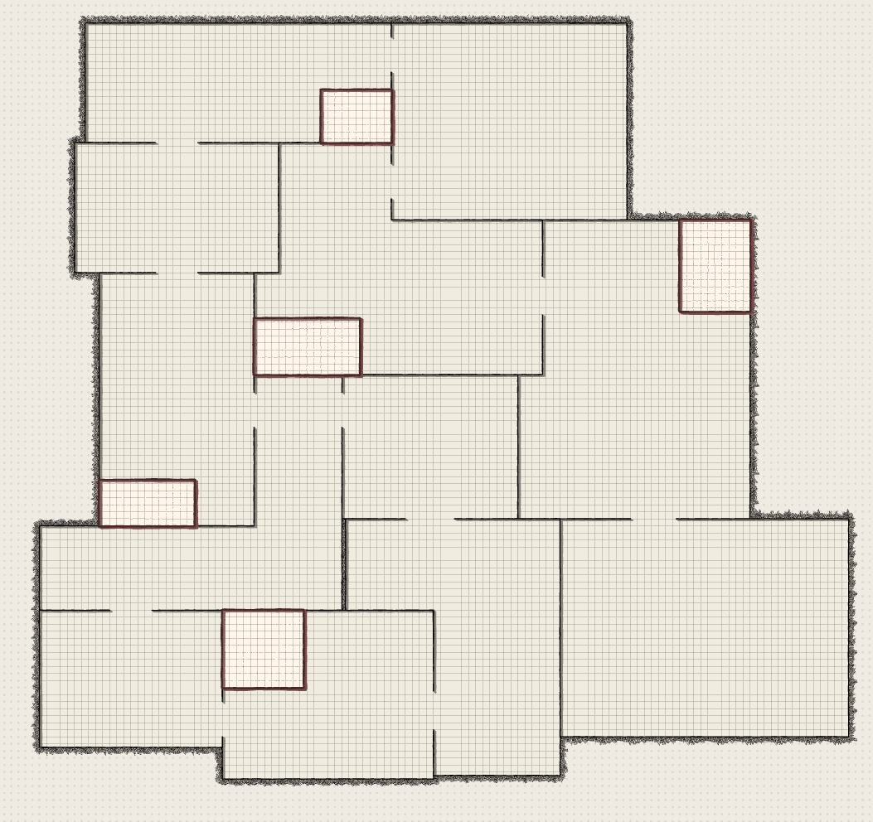
1st Level Design Sketch

Slide 36
Questions

Slide 37
Posible Questions
How is this different from other top-downs
How would you sell/monatise this
What problems did you encounter/deal with
Why this mechanic
How would you improve it

